Slide 1



Maday Alcalá
Andrés Burgos
Melissa Román
John Salazar

Slide 2
What is it?
File Searcher
Converter
Audio/Video Player
Metadata Extractor

Slide 3
Architecture
View
Controller
Data Base
Model

Slide 4
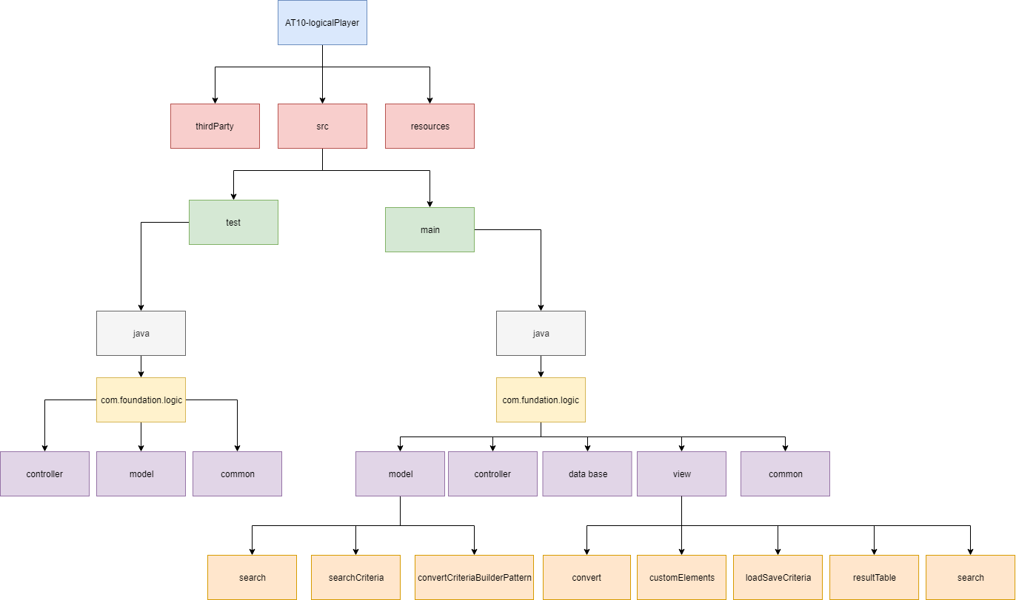
Folders architecture

Slide 5
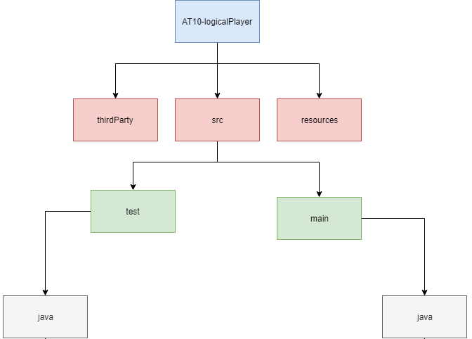
Folders architecture

Slide 6
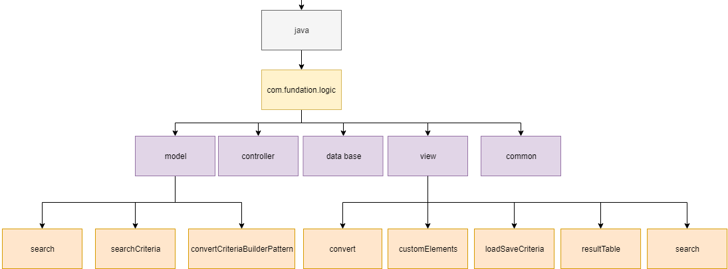
Packages

Slide 7
Design Patterns
Singleton
Factory
Builder

Slide 8
Search
Search Criteria
Factory

Slide 9
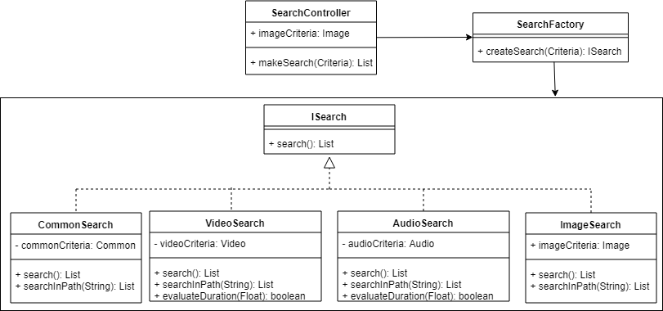
SearchFactory

Slide 10
Database
SQLite
Singleton

Slide 11
Converter
Convert Criteria
Builder

Slide 12
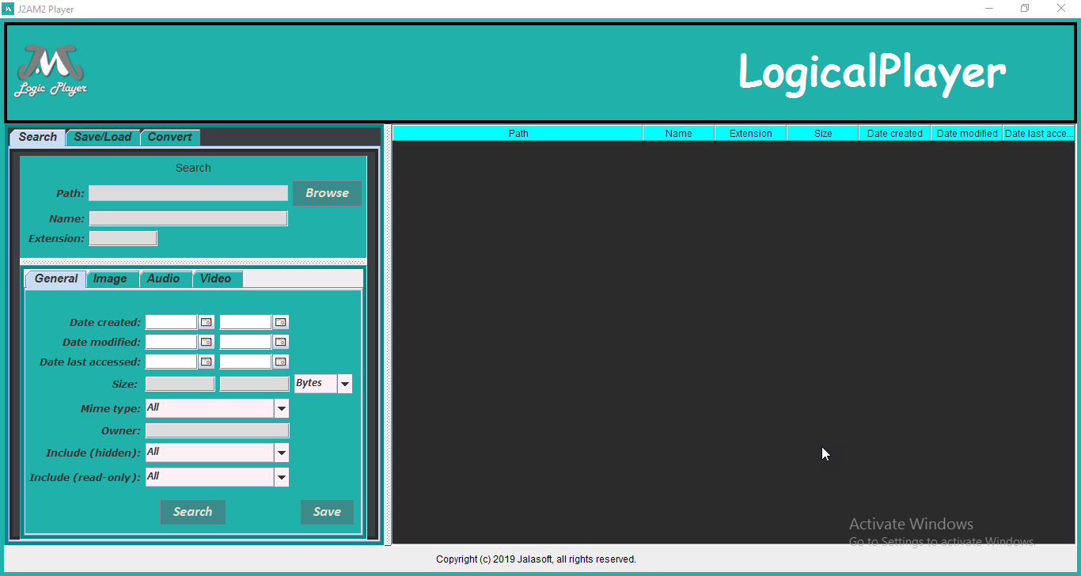
VIEW

Slide 13
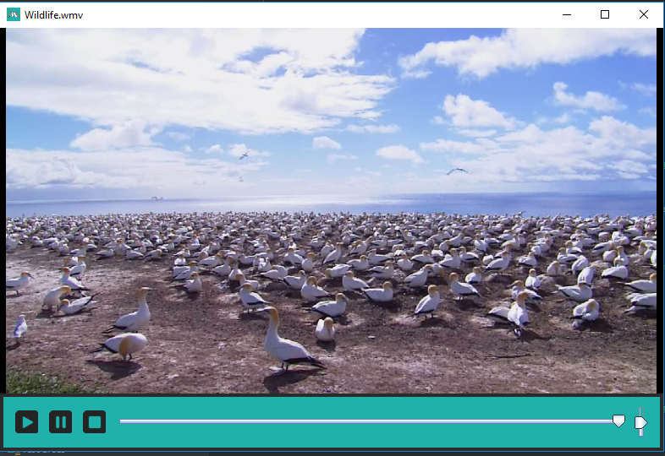
VIEW

Slide 14
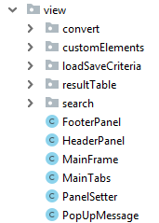
VIEW

Slide 15
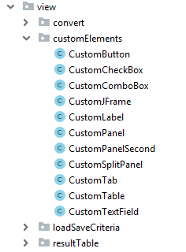
VIEW

Slide 16
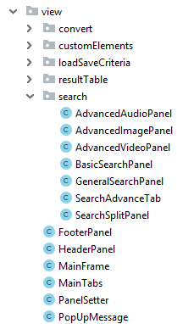
VIEW

Slide 17
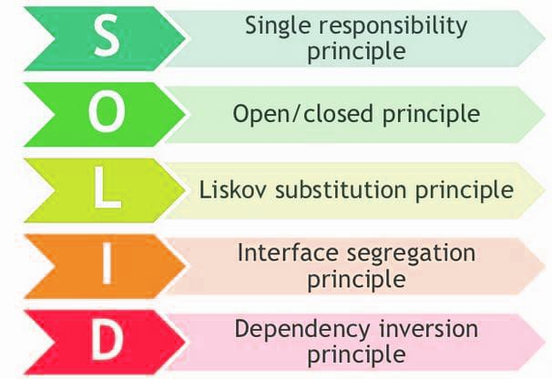
SOLID principles

Slide 18
Tools
WEB Service Converter (Other Team)
Exiftools
VLC
JavaSwing
JUnit

Slide 19
Code coverage
Package | Class, %
com.fundation.logic.common | 100% (10/ 10)
com.fundation.logic.controller | 10% (1/ 10)
com.fundation.logic.model | 100% (5/ 5)
com.fundation.logic.model.convertCriteriaBuilderPattern | 100% (2/ 2)
com.fundation.logic.model.search | 100% (5/ 5)
com.fundation.logic.model.searchCriteria | 100% (6/ 6)
all classes | 76.3% (29/ 38)
(Common, Model & Controller)

Slide 20
Code coverage
Package | Class, %
com.fundation.logic.common | 100% (10/ 10)
com.fundation.logic.model | 100% (5/ 5)
com.fundation.logic.model.convertCriteriaBuilderPattern | 100% (2/ 2)
com.fundation.logic.model.search | 100% (5/ 5)
com.fundation.logic.model.searchCriteria | 100% (6/ 6)
all classes | 100% (28/ 28)
(Common & Model)

Slide 21
Known Bugs
Known Bugs | Priority | Status
Search process takes a lot of time. | 1 | Pending
When error message is shown it takes time to give back the control to the user | 3 | Pending
Convert does not validate input form data. | 2 | Fixed
Search does not validate input form data. | 2 | Fixed
Size textfield allows to enter non-numeric characters. | 3 | Fixed
Size textfield allows to paste non-numeric characters. | 3 | Fixed
Date comparisson does not suport greater or equal. | 2 | Fixed
Date comparisson does not suport lower or equal. | 2 | Fixed
Search by mime type shows incorrect result. | 2 | Fixed
Advance search shows incorrect result. | 2 | Fixed

Slide 22
Enhacements
Enhancements
Improve time of search processing.
Implement multi-thread processing.
Increase search parameters by metadata.
Cleaner feature to reset forms.
Add themes for user interface.
Error message and exceptions management.

Slide 23

Questions

Slide 24

Thank you

